Slide 1
Capstone project
Olivia Sabala

Slide 2
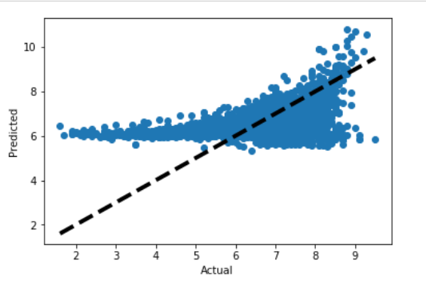
Regression Findings
Linear Regression Model 1

Slide 3
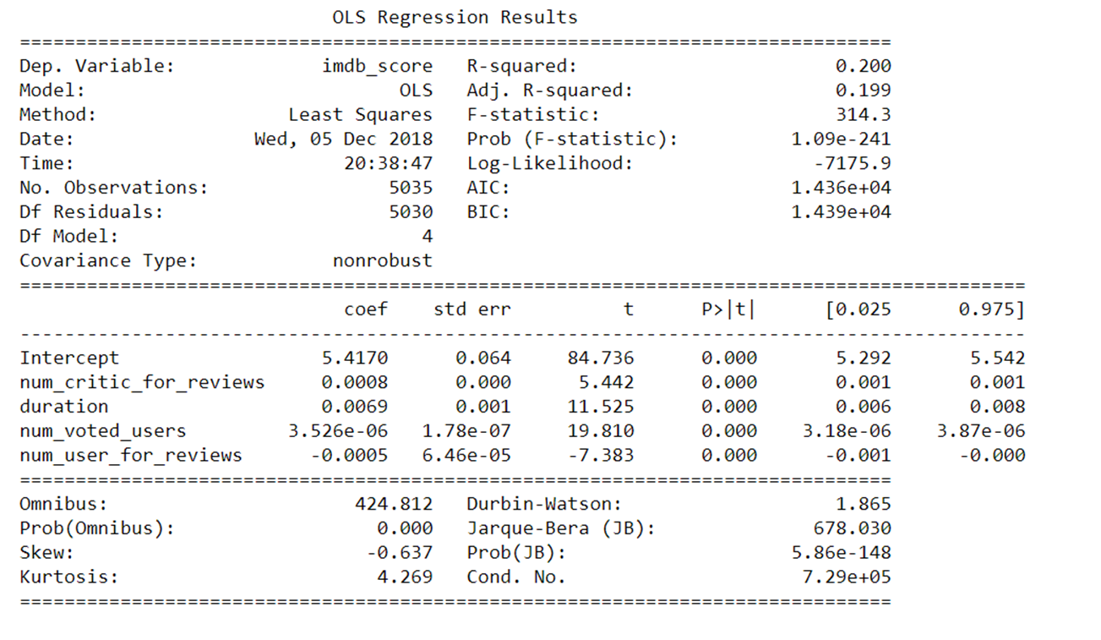

Slide 4
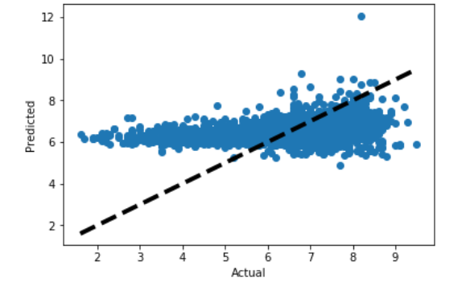
Regression Findings
Linear Regression Model 2

Slide 5
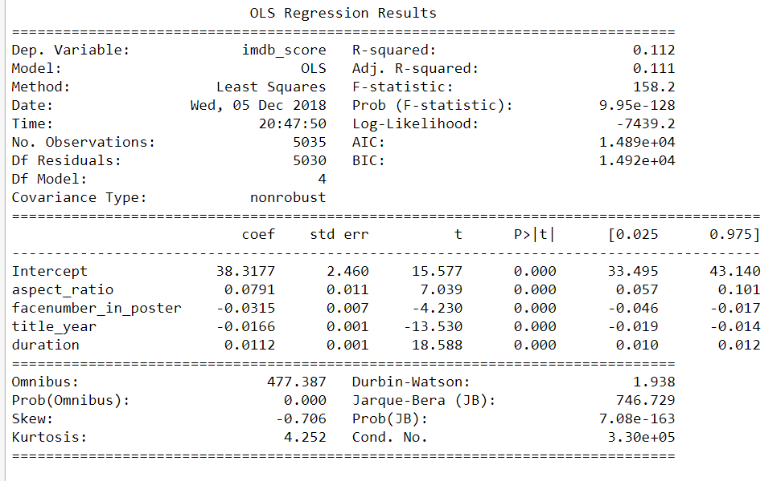

Slide 6
Classification Findings
Decision Tree:
accuracy: 64%
Logistic Regression: used to reduce multicolleanarity
accuracy: 65%
KNN:
accuracy: 50%
Random Forest
accuracy: 59%

Slide 7
Clustering Findings
Using Kmeans, used 4 cluster sizes
Most fell under cluster 2
Facenumber in poster had a few far outliers in cluster 1
I wanted to test what a cluster would look like with a non-significant variable and you can see the drastic difference between a uniform graph and director_facebook_likes

Slide 8
BEST MODEL
Logistic Regression

Slide 9
Story Telling
What variables are considered important to predict imdb_score and movie success?
After running multiple feature selection models my data showed that Recursive Feature Model has the lowest MSE score. The variables chosen were: aspect_ratio, facenumber_in_poster, title_year, and duration. To double check my data I ran both my output for selectKbest and RFE in two different linear regression models. The output from that data shows that the variables selected in RFE are more fitted for this project than selectKbest.

Slide 10
Storying Telling Continued…
What recommendations do you have for movie producers / investors / viewers?
Based off the data my recommendations would be to have a focus on aspect_ration. Most viewers won’t necessarily know what it is or what is does but can tell a difference between the quality of the picture in relationship to sizing on the screen.
Lastly, marketing seems to have a large impact on viewers and ratings. Management should spend more time on marketing the movies, like posters.
What additional variables would you need to improve the model prediction?
Another variable that could be added is the time of year, seasonality can shift views preference of a movie, for example a Christmas movie will receive higher scores around Christmas time than during the summer
Another variable that might be important is the soundtrack and who produces it. Music can make or break a movie.

